Slide 1
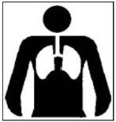
Silica
October 24, 2017
Dust in the Air
Dale Glacken,
Compliance Assistance Specialist
Harrisburg Area Office
Remember: If it's silica, it's not just dust.

Slide 2

R. Alexander Acosta
United States Secretary of Labor

Slide 3
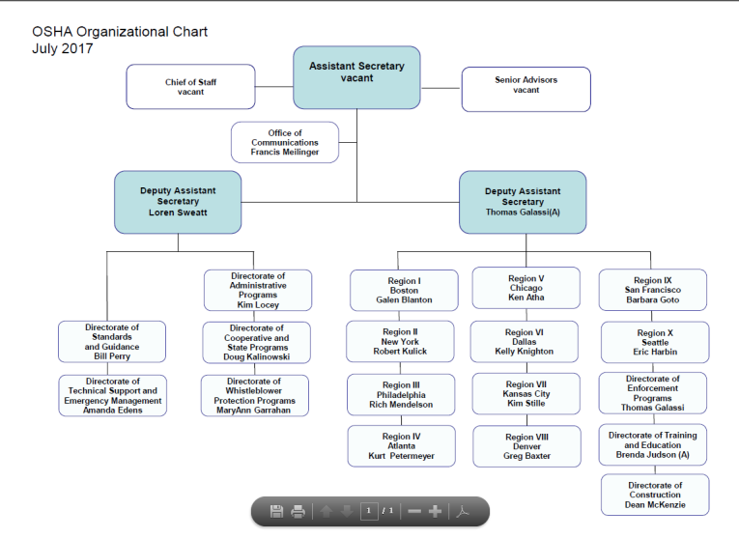
Loren Sweatt
Deputy Assistant Secretary

Slide 4
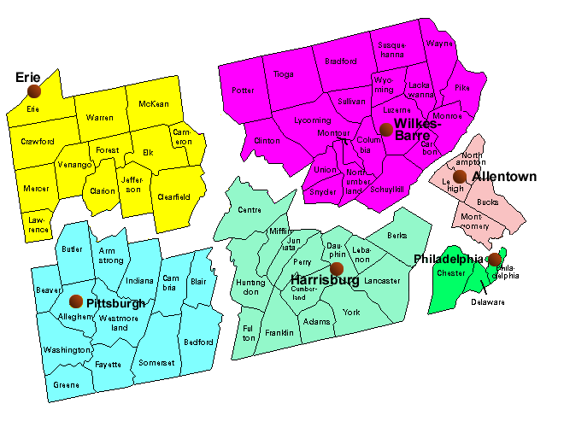
Pennsylvania OSHA Area Offices
Allentown Area Office
(267) 429-7542
Erie Area Office
(814) 874-5150
Harrisburg Area Office
(717) 782-3902
Philadelphia Area Office
(215) 597-4955
Pittsburgh Area Office
(412) 395-4903
Wilkes-Barre Area Office
(570) 826-6538
Mark Stelmack
Brendan Claybaugh
Jean Kulp
Dave Olah
Theresa Downs
Christopher Robinson
Main OSHA Number:
1-800-321-OSHA,
1-800-321-6742
Rev: 2014 April 4

Slide 5
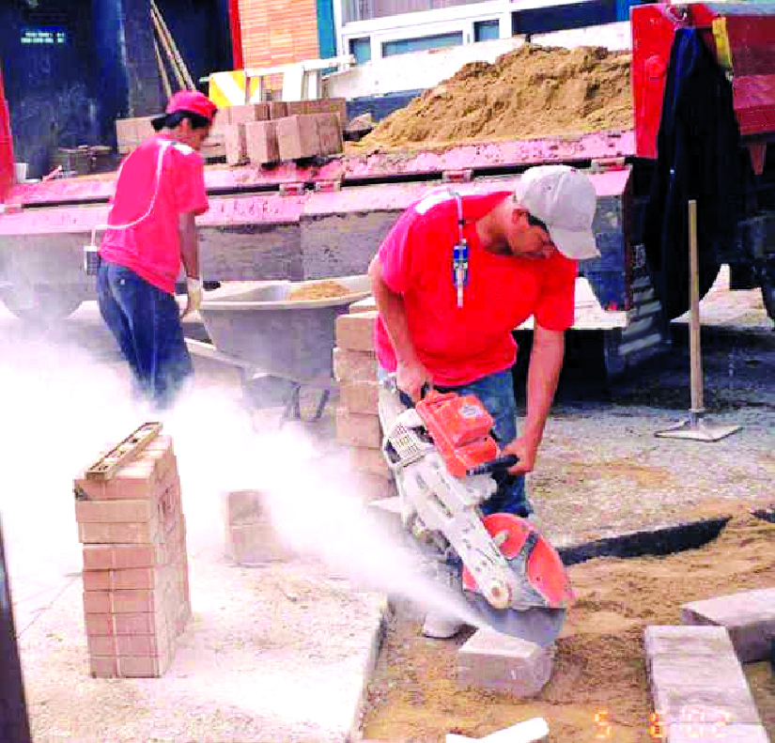
Silica: Regulatory Update
March 25, 2016

Slide 6
CAS Material Developed & Distributed
This information has been developed by an OSHA Compliance Assistance Specialist and is intended to assist employers, workers, and others as they strive to improve workplace health and safety. While we attempt to thoroughly address specific topics [or hazards], it is not possible to include discussion of everything necessary to ensure a healthy and safe working environment in a presentation of this nature. Thus, this information must be understood as a tool for addressing workplace hazards, rather than an exhaustive statement of an employer’s legal obligations, which are defined by statute, regulations, and standards. Likewise, to the extent that this information references practices or procedures that may enhance health or safety, but which are not required by a statute, regulation, or standard, it cannot, and does not, create additional legal obligations. Finally, over time, OSHA may modify rules and interpretations in light of new technology, information, or circumstances; to keep apprised of such developments, or to review information on a wide range of occupational safety and health topics, you can visit OSHA’s website at www.osha.gov.
Notes:
http://intranet.osha.gov/dcsp/LAP/dcsp/compliance_assistance/cas_disclaimer/cas_disclaimer_memo.html#Attachment%20A
We are not going to hit everything today.

Slide 7
Final Rule Published on March 25, 2016

Slide 8
Reasons for the Rule
Current permissible exposure limits (PELs) are formulas that many find hard to understand
Construction/shipyard PELs are obsolete particle count limits
General industry formula PEL is about equal to 100 µg/m³; construction/shipyard formulas are about 250 µg/m³

Slide 9
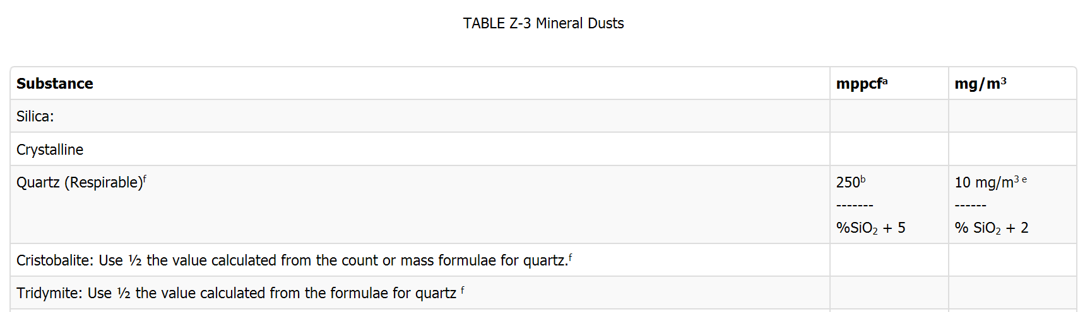
Current/Former Formula

Slide 10
Most Important Reason for the Rule
Current PELs do not adequately protect workers
Extensive epidemiologic evidence that lung cancer and silicosis occur at exposure levels below 100 µg/m³

Slide 11
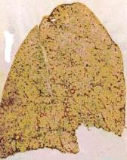
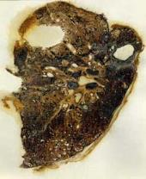
Exposure and Health Risks
Exposure to respirable crystalline silica has been linked to:
  Silicosis;
  Lung cancer;
  Chronic Obstructive Pulmonary Disease (COPD); and
  Kidney disease
  Immune system effects
Healthy Lung
Silicotic Lung

Slide 12
What are the hazards of crystalline silica?
Fatalities and disabling illnesses
Classified as a human lung carcinogen.
An inhalation hazard. The respirable silica dust enters the lungs and causes the formation of scar tissue, thus reducing the lungs’ ability to take in oxygen.
There is no cure for silicosis.
Silicosis affects lung function, it makes one more susceptible to lung infections like tuberculosis.
In addition, smoking causes lung damage and adds to the damage caused by breathing silica dust.

Slide 13
What are the Symptoms of Silicosis?
What are the symptoms of silicosis?
Silicosis is classified into three types: chronic/classic, accelerated, and acute.
Chronic/classic silicosis,
The most common, occurs after 15–20 years of moderate to low exposures to respirable crystalline silica.
Symptoms associated with chronic silicosis may or may not be obvious; therefore, workers need to have a chest x-ray to determine if there is lung damage.
As the disease progresses, the worker may experience shortness of breath upon exercising and have clinical signs of poor oxygen/carbon dioxide exchange.
In the later stages, the worker may experience fatigue, extreme shortness of breath, chest pain, or respiratory failure.

Slide 14
What are the Symptoms of Silicosis?
Accelerated silicosis
Can occur after 5–10 years of high exposures to respirable crystalline silica.
Symptoms include severe shortness of breath, weakness, and weight loss.
The onset of symptoms takes longer than in acute silicosis.
Acute silicosis
Occurs after a few months or as long as 2 years following exposures to extremely high concentrations of respirable crystalline silica.
Symptoms of acute silicosis include severe disabling shortness of breath, weakness, and weight loss, which often leads to death.

Slide 15

What Are the Symptoms of Lung Cancer?
In its early stages, lung cancer normally has no symptoms. When symptoms start to appear, they are usually caused by blocked breathing passages or the spread of cancer further into the lung, surrounding structures, other parts of the body.
Lung cancer symptoms may include:
Chronic, hacking, raspy coughing, sometimes with blood-streaked mucus
Recurring respiratory infections, including bronchitis or pneumonia
Increasing shortness of breath, wheezing, persistent chest pain
Hoarseness
Swelling of the neck and face
Pain and weakness in the shoulder, arm, or hand
Fatigue, weakness, loss of weight and appetite, intermittent fever, severe headaches, and body pain
Difficulty swallowing

Slide 16

Chronic Obstructive Pulmonary Disease (COPD)
COPD describes chronic airflow limitation that is usually irreversible.
COPD includes four interrelated disease processes: chronic bronchitis, emphysema, (asthma), and peripheral airways disease.
Cigarette smoking is a major cause of COPD, but community air pollution and occupational exposure to dust, particularly among smokers, also contribute to COPD.

Slide 17

Chronic Obstructive Pulmonary Disease (COPD)
Symptoms:
You have a cough that won't go away.
You often cough up mucus.
You are often short of breath, especially when you exercise.
You may feel tightness in your chest.

Slide 18
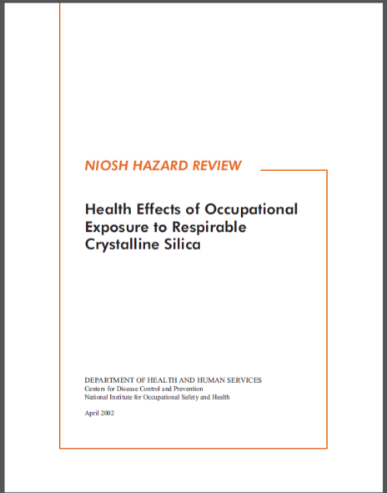
http://www.cdc.gov/niosh/docs/2002-129/pdfs/2002-129.pdf

Slide 19
Health Benefits
OSHA estimates that once the effects of the rule are fully realized, it will prevent:
More than 600 deaths per year
  Lung cancer: 124
  Silicosis and other non-cancer
  lung diseases: 325
  End-stage kidney disease: 193
More than 900 new silicosis cases per year

Slide 20
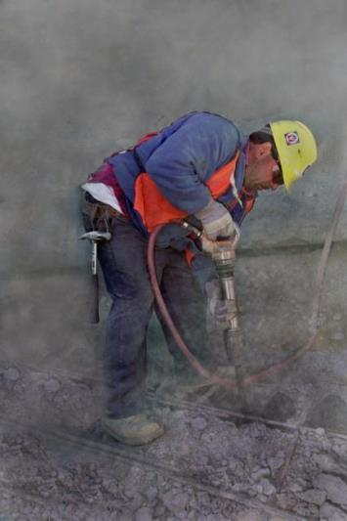
Scope of Coverage
Three forms of silica: quartz, cristobalite and tridymite
Exposures from chipping, cutting, sawing, drilling, grinding, sanding, and crushing of concrete, brick, block, rock, and stone products (such as in construction operations)
Exposures from using sand products (such as glass manufacturing, foundries, and sand blasting)

Slide 21
Industries and Operations with Exposures
Construction Glass manufacturing Pottery products Structural clay products Concrete products Foundries Dental laboratories Paintings and coatings Jewelry production Refractory products Asphalt products | Landscaping Ready-mix concrete Cut stone and stone products Abrasive blasting in: Maritime work Construction General industry Refractory furnace installation and repair Railroads Hydraulic fracturing for gas and oil

Slide 22
Workers and Industries Affected
2.3 million workers:
  Construction: 2 million
  GI/Maritime: 300,000
676,000 establishments
  Construction: 600,000
  GI/Maritime: 76,000

Slide 23
Silica
Look at 3 rules:
Silica standard
Respiratory Protection standard
Hazard Communication standard

Slide 24
Respirable Crystalline Silica Rule
Two standards:
  One for general industry and maritime
  One for construction
Similar to other OSHA health standards and ASTM consensus standards

Slide 25
General Industry/Maritime Standard:
§1910.1053 Respirable crystalline silica
Scope
Definitions
Permissible exposure limit (PEL)
Exposure assessment
Regulated areas
Methods of compliance
  Engineering and work practice controls
  Written exposure control plan
Respiratory protection
Housekeeping
Medical surveillance
Communication of silica hazards
Recordkeeping
Dates

Slide 26
Construction: §1926.1153 Respirable crystalline silica.
Scope
Definitions
Specified exposure control methods
OR
Alternative exposure control methods
  PEL
  Exposure Assessment
  Methods of Compliance
Respiratory protection
Housekeeping
Written exposure control plan
Medical surveillance
Communication of silica hazards
Recordkeeping
Dates

Slide 27
Silica
Complete an inventory of silica operations
Perform an assessment of each
Establish controls (engineering and work procedures)
PPE (respiratory protection)
Housekeeping
Create a written exposure control plan
Communicate/Train the workers, include the work plan
Medical surveillance
Recordkeeping
Review

Slide 28
General Industry/Maritime - Scope
All occupational exposures to respirable crystalline silica are covered, unless objective data shows exposures remain below 25 µg/m³ as an 8-hr TWA under any foreseeable conditions.
Agricultural operations and exposures resulting from processing of sorptive clays are not covered.
General industry employers can follow the construction standard in some very limited circumstances.

Slide 29
Construction - Scope
All occupational exposures to respirable crystalline silica are covered, unless employee exposure will remain below 25 μg/m³ as an 8-hr TWA under any foreseeable conditions.

Slide 30
Permissible Exposure Limit (PEL)
PEL = 50 µg/m³ as an 8-Hour TWA
Action Level = 25 µg/m³ as an 8-Hour TWA

Slide 31
Exposure Assessment
Required if exposures are or may reasonably be expected to be at or above action level of 25 µg/m³
Exposures assessments can be done following:
  The performance option
  The scheduled monitoring option

Slide 32
Performance Option
Exposures assessed using any combination of air monitoring data or objective data sufficient to accurately characterize employee exposure to respirable crystalline silica

Slide 33
Objective Data
Includes air monitoring data from industry-wide surveys or calculations based on the composition of a substance.
It demonstrates employee exposure associated with a particular product or material or a specific process, task, or activity.
Must reflect workplace conditions closely resembling or with a higher exposure potential than the processes, types of material, control methods, work practices, and environmental conditions in the employer's current operations.

Slide 34
Examples of Using Objective Data to Conduct Exposure Assessments under the Performance Option
Industry-wide surveys of typical tasks or operations, which include well-documented procedures for measuring exposures and methods for controlling dust, could be used by employers to characterize employee exposures where employees perform tasks consistent with those described in the survey.
Employers can use direct-reading instruments to measure real-time levels of respirable dust in the air. If the employer has information on the percentage of respirable crystalline silica in that dust (for example, from the analysis of a bulk sample or information from a safety data sheet), he or she can then calculate the level of respirable crystalline silica in air.
Historical data, which are monitoring results collected at any time before the effective date of the standard, could be used to assess employee exposures if the employer can show that the data were collected during work operations and conditions that are consistent with the processes, types of material, control methods, work practices, and environmental conditions in the employer’s current operations.

Slide 35
Scheduled Monitoring Option
Prescribes a schedule for performing initial and periodic personal monitoring
If monitoring indicates:
  Initial below the AL: no additional monitoring
  Most recent at or above the AL: repeat within 6 months
  Most recent above the PEL: repeat within 3 months
  Reassessment: When two consecutive non-initial results, taken 7 or more days apart, are below the AL, monitoring can be discontinued
  Reassess if circumstances change

Slide 36
General Industry/Maritime – Employee Notification
1910.1053(d)(6)(i)
Within 15 working days after completing an exposure assessment in accordance with paragraph (d) of this section, the employer shall individually notify each affected employee in writing of the results of that assessment or post the results in an appropriate location accessible to all affected employees.

Slide 37
Construction –
Employee Notification
1926.1153(d)(2)(vi)(A)
Within five working days after completing an exposure assessment in accordance with paragraph (d)(2) of this section, the employer shall individually notify each affected employee in writing of the results of that assessment or post the results in an appropriate location accessible to all affected employees.

Slide 38
Appendix A – Methods of Sample Analysis
Employers must ensure that samples are analyzed by a laboratory that follows the procedures in Appendix A
Appendix A specifies methods of sample analysis
  Allows for use of OSHA, NIOSH, or MSHA methods
  Analysis must be conducted by accredited laboratories that follow specified quality control procedures

Slide 39
General Industry/Maritime -
Regulated Areas
Required where exposures can reasonably be expected to exceed the PEL
Must be demarcated in any manner that limits workers in the area
Must post warning signs at entrances
Respirator use required

Slide 40
Methods of Compliance –
Hierarchy of Controls
Employers can use any engineering or work practice controls to limit exposures to the PEL
Respirators permitted where PEL cannot be achieved with engineering and work practice controls

Slide 41
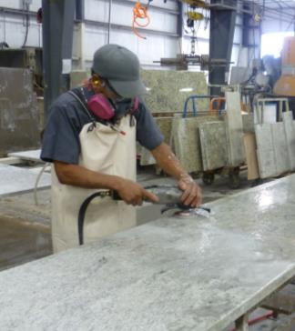
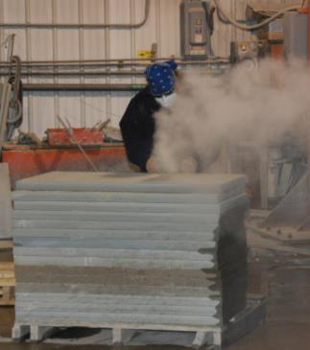
Engineering Controls
Grinding stone
without engineering controls
Polishing stone using water to control the dust

Slide 42
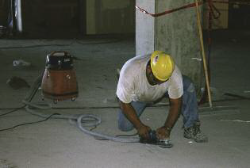
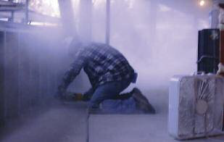
Engineering Controls
Grinding without engineering controls
Grinding using a vacuum
dust collector

Slide 43
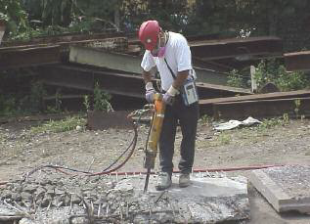
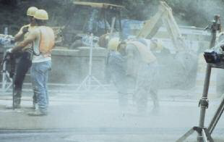
Engineering Controls (cont.)
Jackhammer use without engineering controls
Jackhammer use with water spray to control dust

Slide 44
Controls
Best if controlled at the source.
Wet cutting: Other considerations: freezing temperature, electrical safety
Vacuum Dust Collection (VDC) (not as effective as wet cutting)
Ventilation Booths
Fans (not good by themselves, but supplement other control methods.
Establish work rules and training to share expectations.

Slide 45
General Industry/Maritime -
Written Exposure Control Plan
The plan must describe:
  Tasks involving exposure to respirable crystalline silica
  Engineering controls, work practices, and respiratory protection for each task
  Housekeeping measures used to limit exposure
  Conduct an annual review of the plan at least once a year and update as necessary.

Slide 46
Construction –
Written Exposure Control Plan
The plan must describe:
  Tasks involving exposure to respirable crystalline silica
  Engineering controls, work practices, and respiratory protection for each task
  Housekeeping measures used to limit exposure
  Construction: Procedures used to restrict access, when necessary to limit exposures
  Conduct an annual review of the plan at least once a year and update as necessary.

Slide 47
Respiratory Protection
Must comply with 29 CFR 1910.134
Respirators required for exposures above the PEL:
  While installing or implementing controls or work practices
  For tasks where controls or work practices are not feasible
  When feasible controls cannot reduce exposures to the PEL
  While in a regulated area (General Industry/Maritime)

Slide 48
Housekeeping
When it can contribute to exposure, employers must not allow:
  Dry sweeping or brushing
  Use of compressed air for cleaning surfaces or clothing, unless it is used with ventilation to capture the dust
Those methods can be used if no other methods like HEPA vacuums, wet sweeping, or use of ventilation with compressed air are feasible

Slide 49
General Industry/Maritime -
Medical Surveillance
Employers must offer medical examinations to workers:
  Who will be exposed above the action level for 30 or more days a year
Employers must offer examinations every three years to workers who continue to be exposed above the trigger
Exam includes medical and work history, physical exam, chest X-ray, and pulmonary function test (TB test on initial exam only)

Slide 50
Construction –
Medical Surveillance
Employers must offer medical examinations to workers:
  Who will be required to wear a respirator under the standard for 30 or more days a year.
Employers must offer examinations every three years to workers who continue to be exposed above the trigger
Exam includes medical and work history, physical exam, chest X-ray, and pulmonary function test (TB test on initial exam only)

Slide 51
Medical Opinion
Worker receives report with detailed medical findings
Employer receives an opinion that only describes limitations on respirator use, and if the worker gives written consent, recommendations on:
  Limitations on exposure to respirable crystalline silica, and/or
  Examination by a specialist

Slide 52
Communication of Hazards
Employers required to comply with hazard communication standard (HCS) (29 CFR 1910.1200)
Address: Cancer, lung effects, immune system effects, and kidney effects as part of HCS
Train workers on: health hazards, specific tasks resulting in exposure, workplace protections, standard, and medical surveillance.
Construction: Identify the Competent Person

Slide 53
Under the Hazard Communication Standard Employers must:
Inform employees about the general requirements of HCS, as well as where and how they can view the written hazard communication program, lists of hazardous chemicals, and SDSs.
Train employees on how the presence or release of hazardous chemicals in the work area is detected; in the case of respirable crystalline silica, this could include methods the employer uses to measure exposures, such as air sampling or objective data. If employers are using Table 1, they can train employees to recognize that an increase in visible dust is a sign that a control may not be working properly.
Train employees on the details of the workplace-specific hazard communication program developed by the employer, such as container labels, the workplace labeling system, SDSs (including the order in which the information is presented), and how employees can get and use hazard information.

Slide 54
Training Topics
Employees can demonstrate knowledge and understanding of at least:
Health hazards associated with respirable crystalline silica exposure.
Specific workplace tasks that could expose employees to respirable crystalline silica.
Specific measures the employer is implementing to protect employees. Specific for each task that each employee performs.
  The full and proper use of the controls on those tools; and
  Signs that controls may not be functioning properly.
Laborers who do not operate equipment but are engaged in a task by helping the tool operator would only need to demonstrate knowledge and understanding of:
  The general types of controls used in the workplace,
  Work practices they perform as part of helping the tool operator,
The contents of the respirable crystalline silica standard.
The identity of the competent person designated by the employer.
The purpose and a description of the medical surveillance program required under the standard

Slide 55
Recordkeeping
Must maintain records per 29 CFR 1910.1020 for:
  Air monitoring data
  Objective data
  Medical records

Slide 56
General Industry/Maritime –
Compliance Dates
Employers must comply with all requirements of the standard by June 23, 2018, except :
  Employers must comply with the action level trigger for medical surveillance by June 23, 2020. (The PEL is the trigger from June 23, 2018 through June 23, 2020.)
  Hydraulic fracturing operations in the oil and gas industry must implement engineering controls to limit exposures to the new PEL by June 23, 2021.

Slide 57
Construction –
Compliance Dates
Employers must comply with all requirements (except methods of sample analysis) by June 23, 2017
Compliance with methods of sample analysis required by June 23, 2018

Slide 58
Construction
Scope
Definitions
Specified exposure control methods
OR
Alternative exposure control methods
  PEL
  Exposure Assessment
  Methods of Compliance
Respiratory protection
Housekeeping
Written exposure control plan
Medical surveillance
Communication of silica hazards
Recordkeeping
Dates

Slide 59
Construction - Scope
All occupational exposures to respirable crystalline silica are covered, unless employee exposure will remain below 25 μg/m³ as an 8-hr TWA under any foreseeable conditions.

Slide 60
Construction -
Specified Exposure Control Methods
Table 1 in the construction standard matches 18 tasks with effective dust control methods and, in some cases, respirator requirements.
Employers that fully and properly implement controls on Table 1 do not have to:
  Comply with the PEL
  Conduct exposure assessments for employees engaged in those tasks

Slide 61
Construction - Example of Table 1 Entry
Equipment / Task | Engineering and Work Practice Control Methods | Required Respiratory Protection and Minimum APF
 |  | ≤ 4 hr/shift | > 4 hr/shift
Hand-held power saw (any blade diameter) | Use saw equipped with integrated water delivery system that continuously feeds water to the blade. Operate and maintain tool in accordance with manufacturers’ instruction to minimize dust When used outdoors When used indoors or in an enclosed area | None APF 10 | APF 10 APF 10

Slide 62
Example of Table 1 Entry
Equipment / Task | Engineering and Work Practice Control Methods | Required Respiratory Protection and Minimum APF
 |  | ≤ 4 hr/shift | > 4 hr/shift
Stationary masonry saws | Use saw equipped with integrated water delivery system that continuously feeds water to the blade. Operate and maintain tool in accordance with manufacturer’s instructions to minimize dust emissions. | None | None

Slide 63
Example of Table 1 Entry
Equipment / Task | Engineering and Work Practice Control Methods | Required Respiratory Protection and Minimum APF
 |  | ≤ 4 hr/shift | > 4 hr/shift
Vehicle-mounted drilling rigs for rock and concrete | Use dust collection system with close capture hood or shroud around drill bit with a low-flow water spray to wet the dust at the discharge point from the dust collector. OR Operate from within an enclosed cab and use water for dust suppression on drill bit. | None None | None None

Slide 64
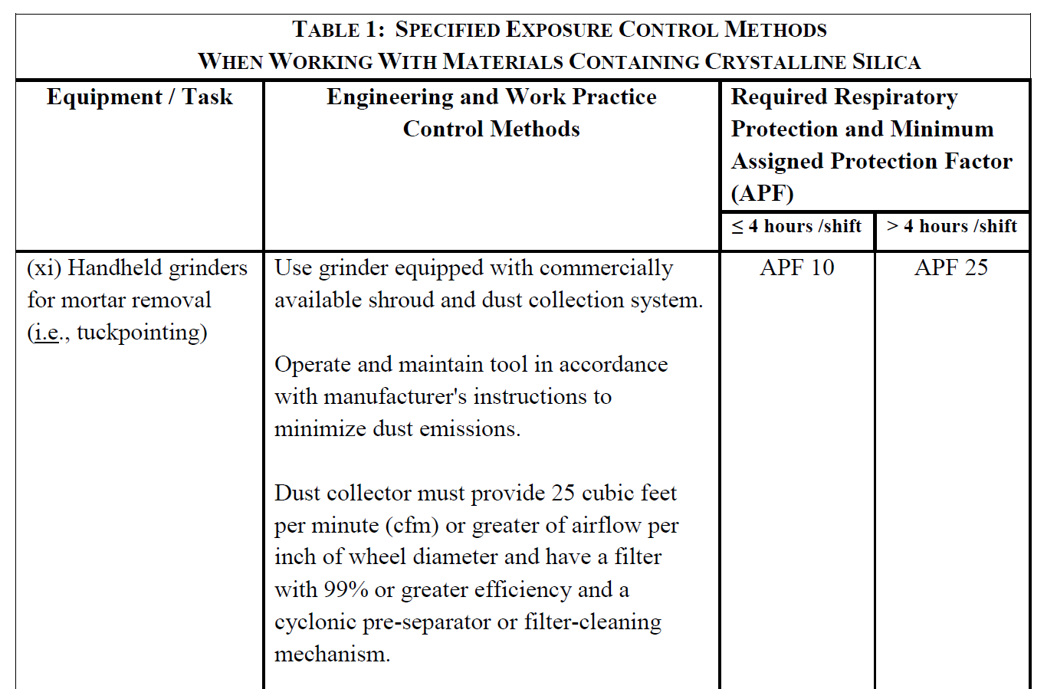
Example of Table 1 Entry

Slide 65
TABLE 1 – ASSIGNED PROTECTION FACTORS⁵
Respirator Type^{1, 2} | Quarter Mask | Half Mask | Full Face | Helmet/Hood | Loose-Fitting
Air Purifying | 5 | ³10 | 50 | ----------------- | -----------------
PAPR | -------------------- | 50 | 1,000 | ⁴25/1,000 | 25
SAR Demand Continuous Flow Pressure Demand/ other (+) pressure | -------------------- -------------------- -------------------- | 10 50 50 | 50 1,000 1,000 | --------------------- ⁴25/1,000 --------------------- | -------------------- 25 --------------------
SCBA Demand Pressure Demand/ other (+) pressure | -------------------- -------------------- | 10 ------------------ | 50 10,000 | 50 10,000 | ----------------------------------------

Slide 66
NOTES TO TABLE 1 –
ASSIGNED PROTECTION FACTORS⁵
¹May use respirators assigned for higher concentrations in lower concentrations or when required use is independent of concentration.
²These APF’s are only effective when employer has a continuing, effective respirator program per 1910.134.
³This APF category includes filtering facepieces and elastomeric facepieces.
⁴Must have manufacturer test evidence to support an APF of 1,000 or else these respirators receive an APF of 25.
⁵These APFs do not apply to escape-only respirators. Escape respirators must conform to 1910.134(d)(2)(ii) or OSHA’s substance specific standards, if used with those substances.
{1910.134(d)(3)(i)(A)}

Slide 67
Construction - List of Table 1 Entries
Stationary masonry saws
Handheld power saws
Handheld power saws for fiber cement board
Walk-behind saws
Drivable saws
Rig-mounted core saws or drills
Handheld and stand-mounted drills
Dowel drilling rigs for concrete
Vehicle-mounted drilling rigs for rock and concrete
Jackhammers and handheld powered chipping tools
Handheld grinders for mortar removal (tuckpointing)
Handheld grinders for other than mortar removal
Walk-behind milling machines and floor grinders
Small drivable milling machines
Large drivable milling machines
Crushing machines
Heavy equipment and utility vehicles to abrade or fracture silica materials
Heavy equipment and utility vehicles for grading and excavating

Slide 68
Fully and Properly Implementing Controls Specified on Table 1
Presence of controls is not sufficient.
Employers are required to ensure that:
  Controls are present and maintained
  Employees understand the proper use of those controls and use them accordingly

Slide 69
Employees Engaged in Table 1 Tasks
Employees are “engaged in the task” when operating the listed equipment, assisting with the task, or have some responsibility for the completion of the task
Employees are not “engaged in the task” if they are only in the vicinity of a task

Slide 70
Respiratory Protection Requirements on Table 1
Respirators required where exposures above the PEL are likely to persist despite full and proper implementation of the specified engineering and work practice controls
Where respirators required, must be used by all employees engaged in the task for entire duration of the task
Provisions specify how to determine when respirators are required for an employee engaged in more than one task

Slide 71
Construction –
Competent Person
Construction employers must designate a competent person to implement the written exposure control plan
Competent person is an individual capable of identifying existing and foreseeable respirable crystalline silica hazards, who has authorization to take prompt corrective measures
Makes frequent and regular inspection of job sites, materials, and equipment

Slide 72
Construction –
Compliance Dates
Employers must comply with all requirements (except methods of sample analysis) by June 23, 2017
Compliance with methods of sample analysis required by June 23, 2018
DELAY
Until Sept 23,2017

Slide 73
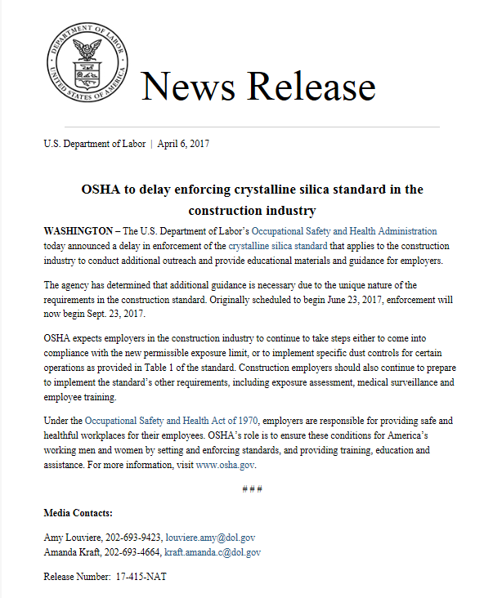
Originally scheduled to begin June 23, 2017, enforcement will now begin Sept. 23, 2017.
https://content.govdelivery.com/accounts/USDOL/bulletins/192ac7a

Slide 74
Guidance and Outreach
Silica Rulemaking Webpage: www.osha.gov/silica
  Fact sheets
  FAQs
  Video
  Small Entity Compliance Guide
Appendix B – Medical Surveillance Guidelines
Coming soon after publication:
  PowerPoint template
  Directive

Slide 75
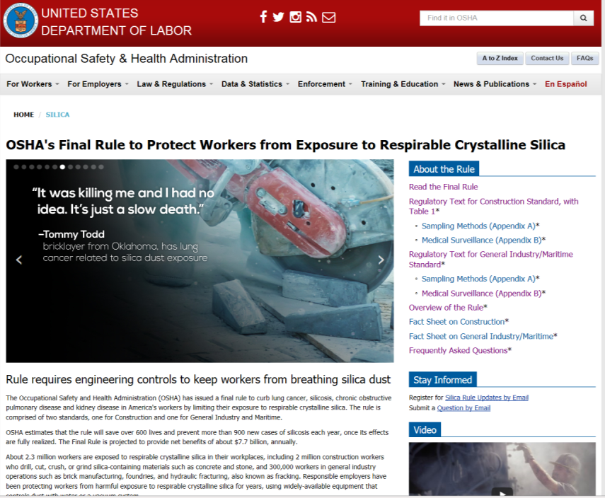
http://www.osha.gov/silica/index.html

Slide 76

https://www.osha.gov/Publications/OSHA3902.pdf

Slide 77
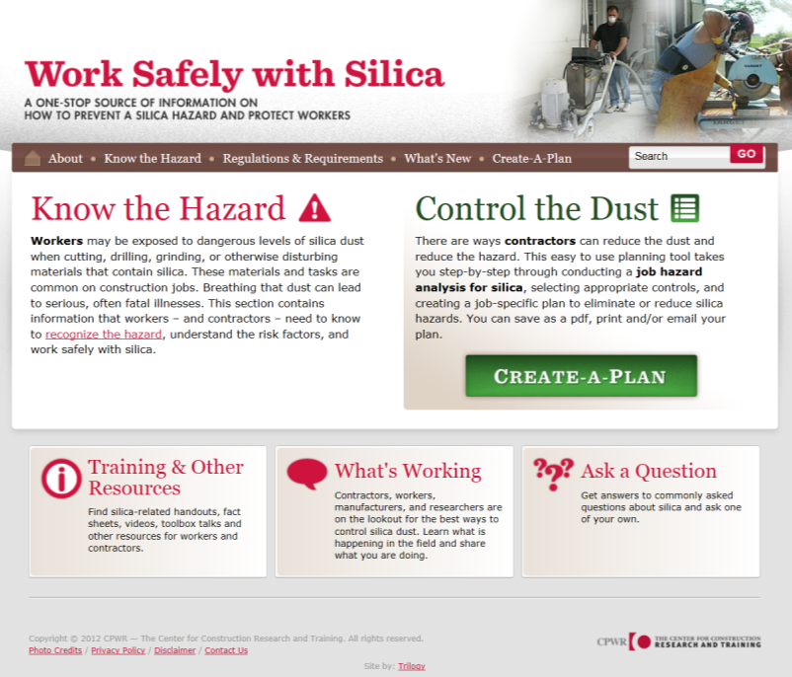
http://www.silica-safe.org/

Slide 78
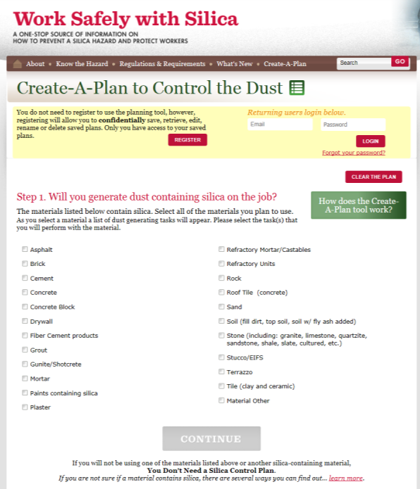

Slide 79
Silica
Complete an inventory of silica operations
Perform an assessment of each
Establish controls (engineering and work procedures)
PPE (respiratory protection)
Housekeeping
Create a written exposure control plan
Communicate/Train the workers, include the work plan
Medical surveillance
Recordkeeping
Review

Slide 80
Pennsylvania OSHA Area Offices
Allentown Area Office
(267) 429-7542
Erie Area Office
(814) 874-5150
Harrisburg Area Office
(717) 782-3902
Philadelphia Area Office
(215) 597-4955
Pittsburgh Area Office
(412) 395-4903
Wilkes-Barre Area Office
(570) 826-6538
Mark Stelmack
Brendan Claybaugh
Jean Kulp
Dave Olah
Theresa Downs
Christopher Robinson
Main OSHA Number:
1-800-321-OSHA,
1-800-321-6742
Rev: 2014 April 4

Slide 81
Additional Assistance
Harrisburg Area Office
Duty Officer Hours
8:00 am - 4:30 pm
(717) 782-3902
Web Site: www.osha.gov

Slide 82

Questions?

Slide 83


